Slide 1
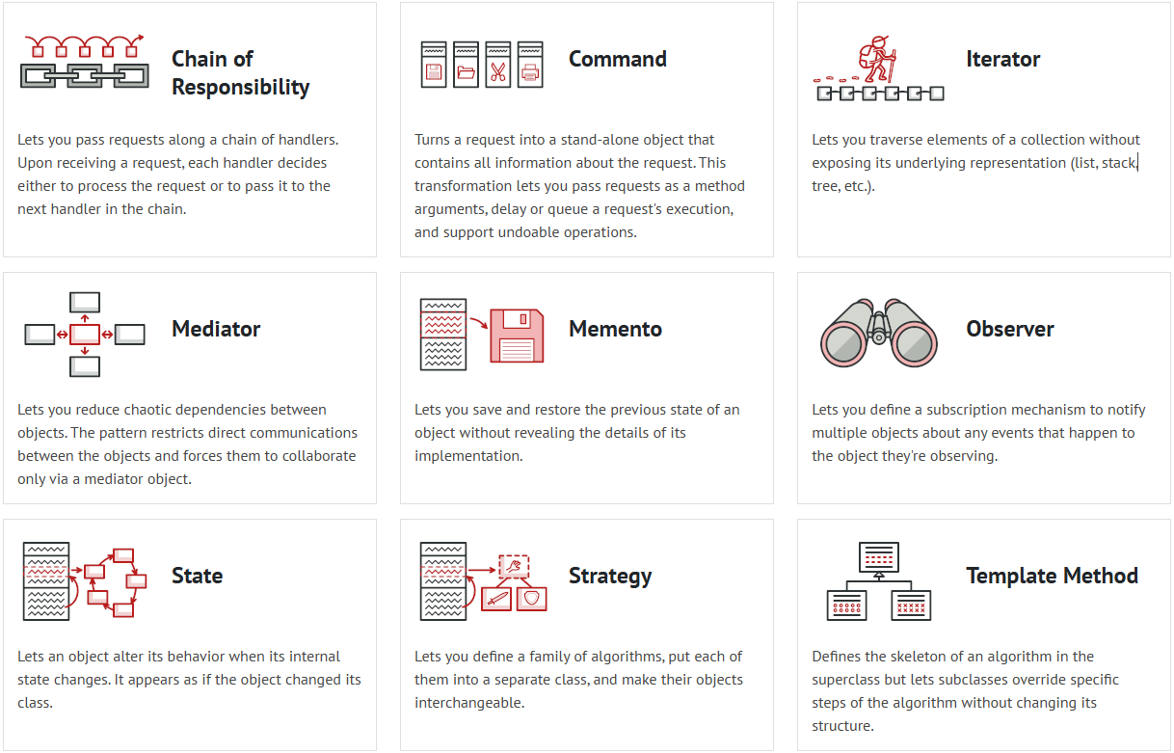
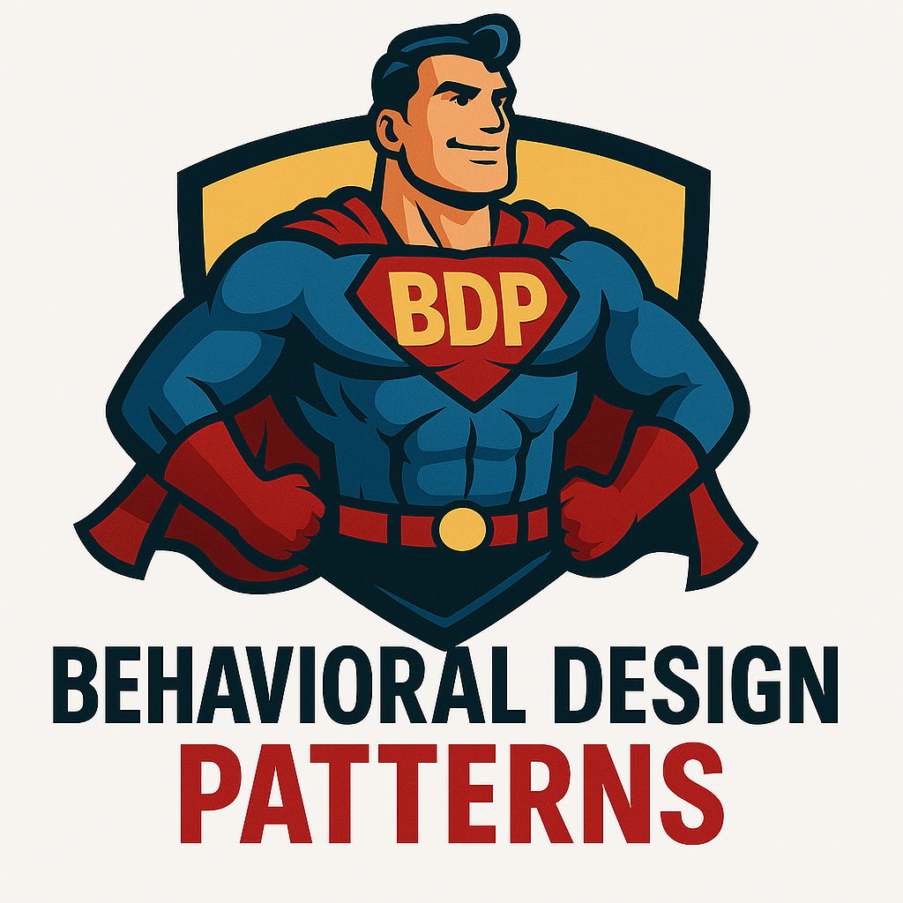
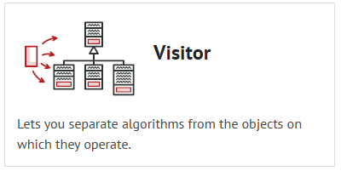
What is Behavioral Design Patterns?
Behavioral design patterns are concerned with algorithms and the assignment of responsibilities between objects.

Slide 2
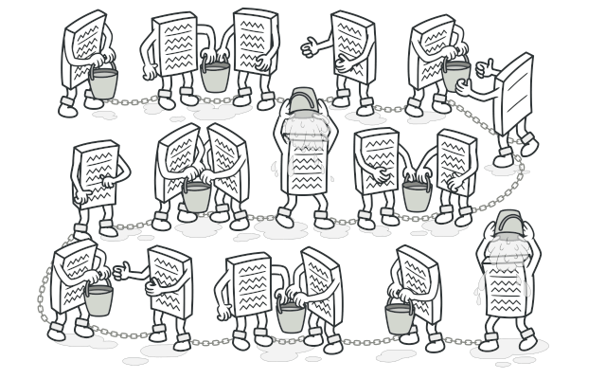
CHAIN OF RESPONSIBILITY Chain of Responsibility is a behavioral design pattern that lets you pass requests along a chain of handlers. Upon receiving a request, each handler decides either to process the request or to pass it to the next handler in the chain.
Applicability
Use the Chain of Responsibility pattern when your program is expected to process different kinds of requests in various ways, but the exact types of requests and their sequences are unknown beforehand.
Use the pattern when it’s essential to execute several handlers in a particular order.
Use the CoR pattern when the set of handlers and their order are supposed to change at runtime.
Use Cases: Logging, Middleware in Web Frameworks.

Slide 3
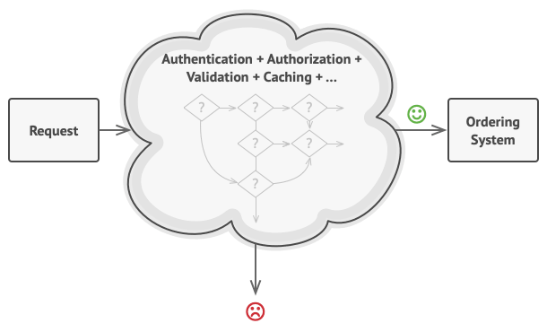
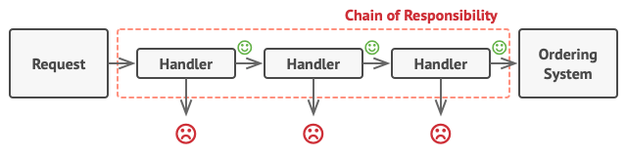
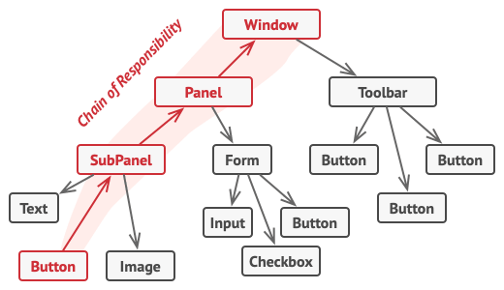
Problem & Solution
Problem Imagine that you’re working on an online ordering system. You want to restrict access to the system so only authenticated users can create orders. Also, users who have administrative permissions must have full access to all orders.
After a bit of planning, you realized that these checks must be performed sequentially. The application can attempt to authenticate a user to the system whenever it receives a request that contains the user’s credentials. However, if those credentials aren’t correct and authentication fails, there’s no reason to proceed with any other checks.
Solution
Like many other behavioral design patterns, the Chain of Responsibility relies on transforming particular behaviors into stand-alone objects called handlers. In our case, each check should be extracted to its own class with a single method that performs the check. The request, along with its data, is passed to this method as an argument.
The pattern suggests that you link these handlers into a chain. Each linked handler has a field for storing a reference to the next handler in the chain. In addition to processing a request, handlers pass the request further along the chain. The request travels along the chain until all handlers have had a chance to process it.

Slide 4
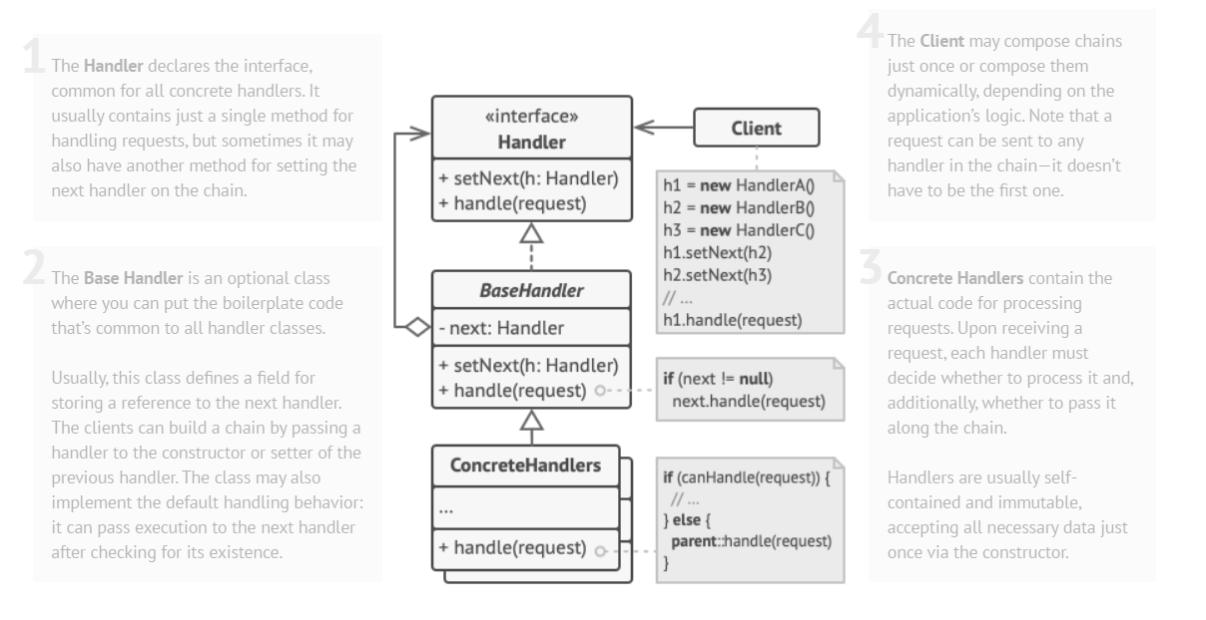
Structure

Slide 5
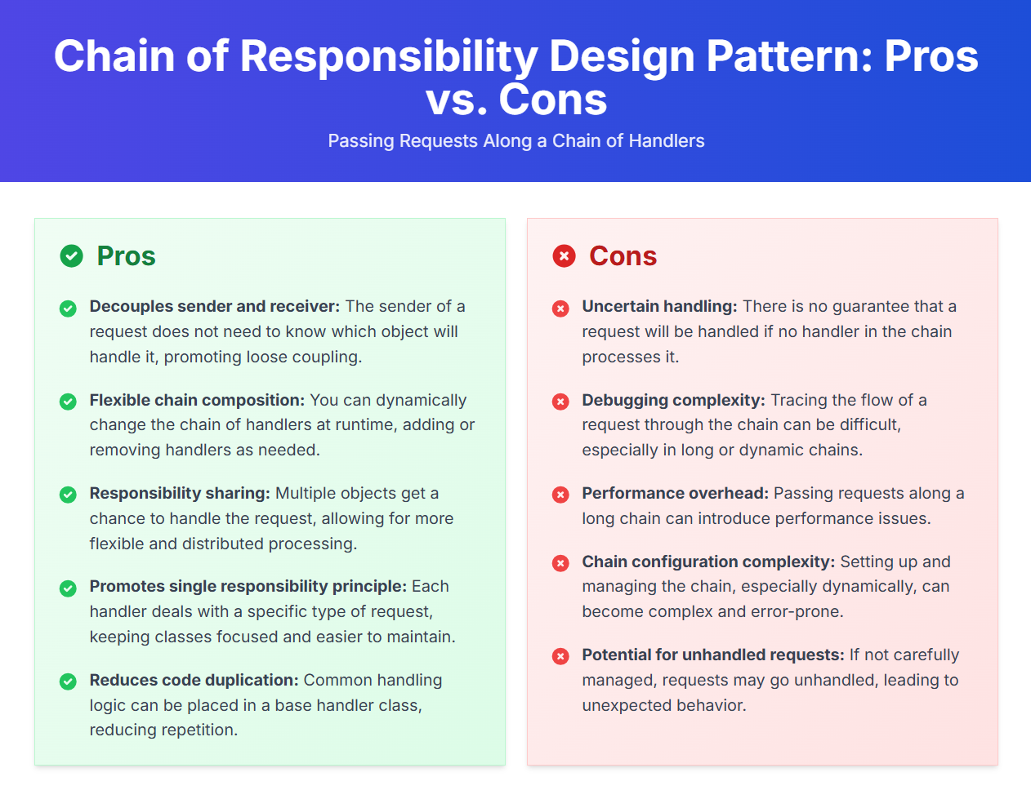

Slide 6
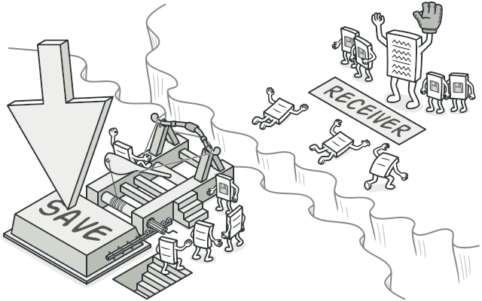
COMMAND Command is a behavioral design pattern that turns a request into a stand-alone object that contains all information about the request. This transformation lets you pass requests as a method arguments, delay or queue a request’s execution, and support undoable operations.
Applicability
Use the Command pattern when you want to parametrize objects with operations.
Use the Command pattern when you want to queue operations, schedule their execution, or execute them remotely.
Use the Command pattern when you want to implement reversible operations.
Use Cases: Undo/Redo Functionality, Implementing Remote Controls.

Slide 7
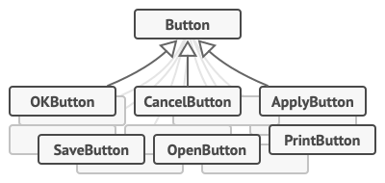
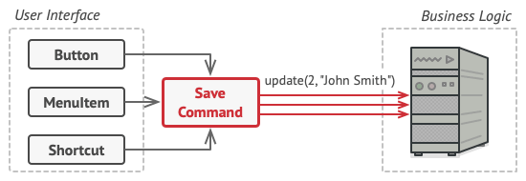
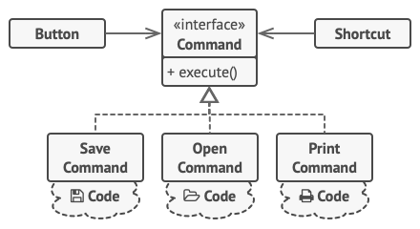
Problem & Solution
Problem Imagine that you’re working on a new text-editor app. Your current task is to create a toolbar with a bunch of buttons for various operations of the editor. You created a very neat Button class that can be used for buttons on the toolbar, as well as for generic buttons in various dialogs.
Initially, when our app only had the toolbar, it was okay to place the implementation of various operations into the button subclasses. In other words, having the code for copying text inside the Copy Button subclass was fine. But then, when you implement context menus, shortcuts, and other stuff, you have to either duplicate the operation’s code in many classes or make menus dependent on buttons, which is an even worse option.
Solution
Good software design is often based on the principle of separation of concerns, which usually results in breaking an app into layers. The most common example: a layer for the graphical user interface and another layer for the business logic. The GUI layer is responsible for rendering a beautiful picture on the screen, capturing any input and showing results of what the user and the app are doing. However, when it comes to doing something important, like calculating the trajectory of the moon or composing an annual report, the GUI layer delegates the work to the underlying layer of business logic.

Slide 8
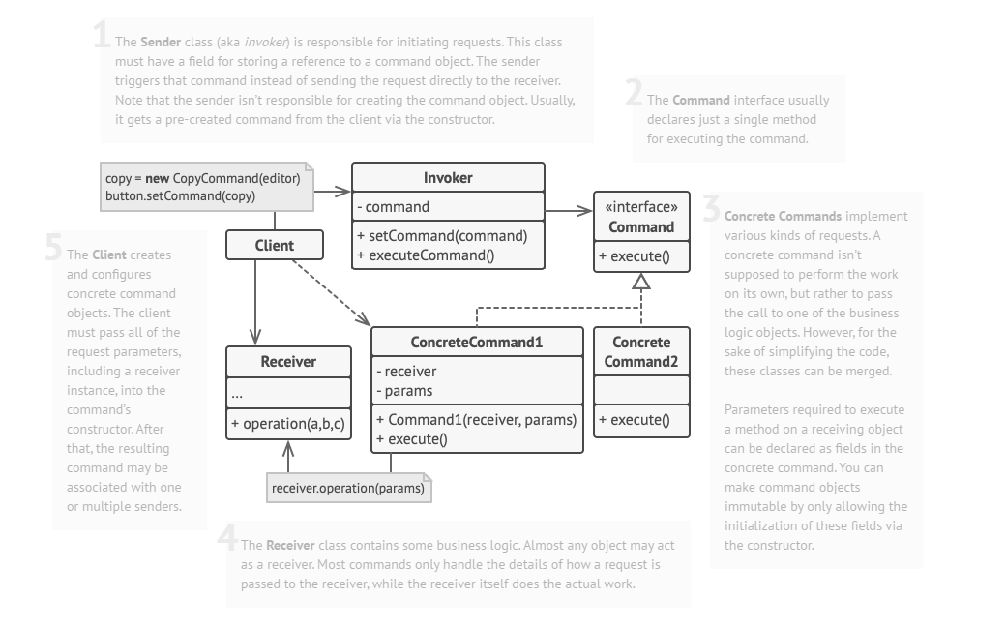
Structure

Slide 9
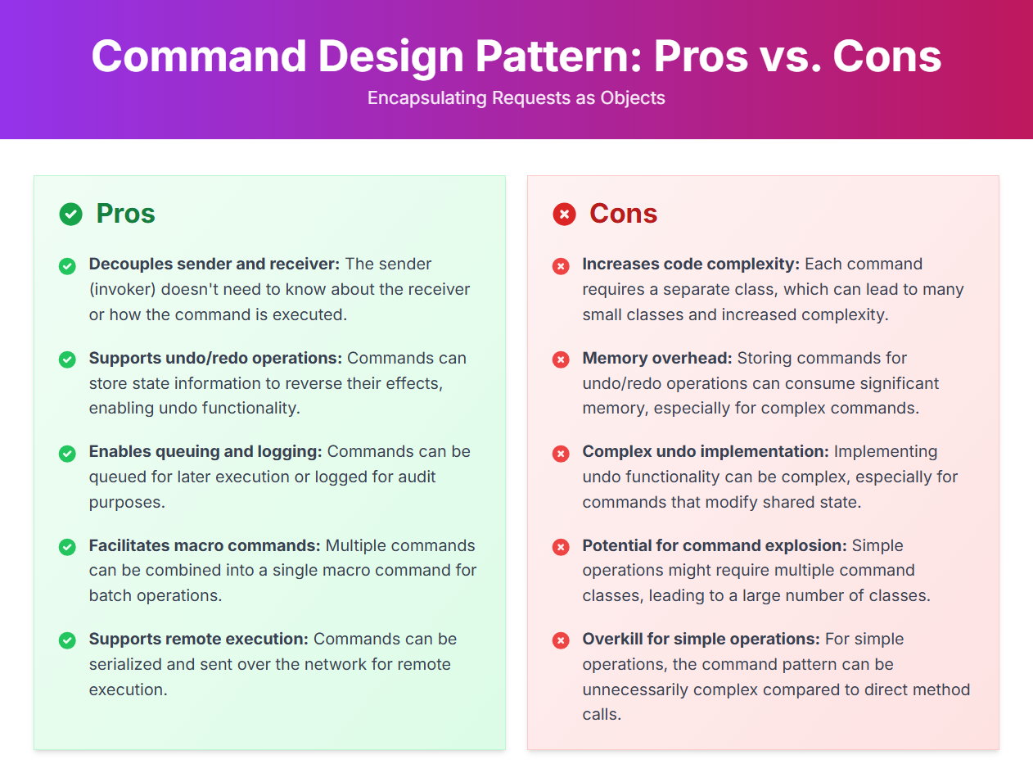

Slide 10
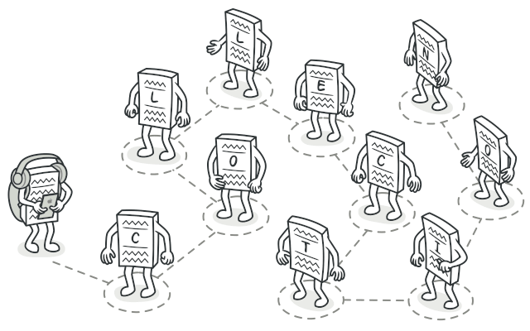
ITERATOR Iterator is a behavioral design pattern that lets you traverse elements of a collection without exposing its underlying representation (list, stack, tree, etc.).
Applicability
Use the Iterator pattern when your collection has a complex data structure under the hood, but you want to hide its complexity from clients (either for convenience or security reasons).
Use the pattern to reduce duplication of the traversal code across your app.
Use the Iterator when you want your code to be able to traverse different data structures or when types of these structures are unknown beforehand.
Use Cases: Traversing Collections, Navigating a file system.

Slide 11
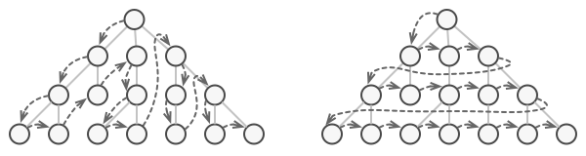
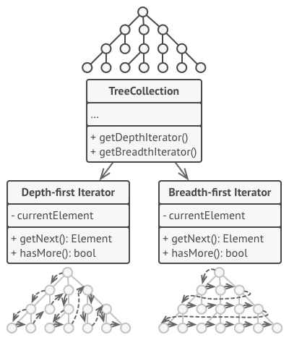
Problem & Solution
Problem
Collections are one of the most used data types in programming. Nonetheless, a collection is just a container for a group of objects.
This may sound like an easy job if you have a collection based on a list. You just loop over all of the elements. But how do you sequentially traverse elements of a complex data structure, such as a tree? For example, one day you might be just fine with depth-first traversal of a tree. Yet the next day you might require breadth-first traversal. And the next week, you might need something else, like random access to the tree elements.
Solution
In addition to implementing the algorithm itself, an iterator object encapsulates all of the traversal details, such as the current position and how many elements are left till the end. Because of this, several iterators can go through the same collection at the same time, independently of each other.

Slide 12
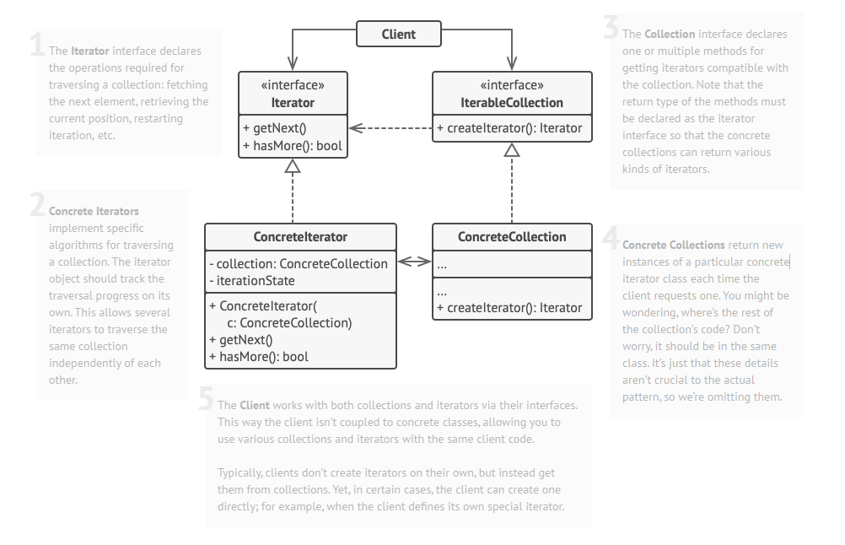
Structure

Slide 13
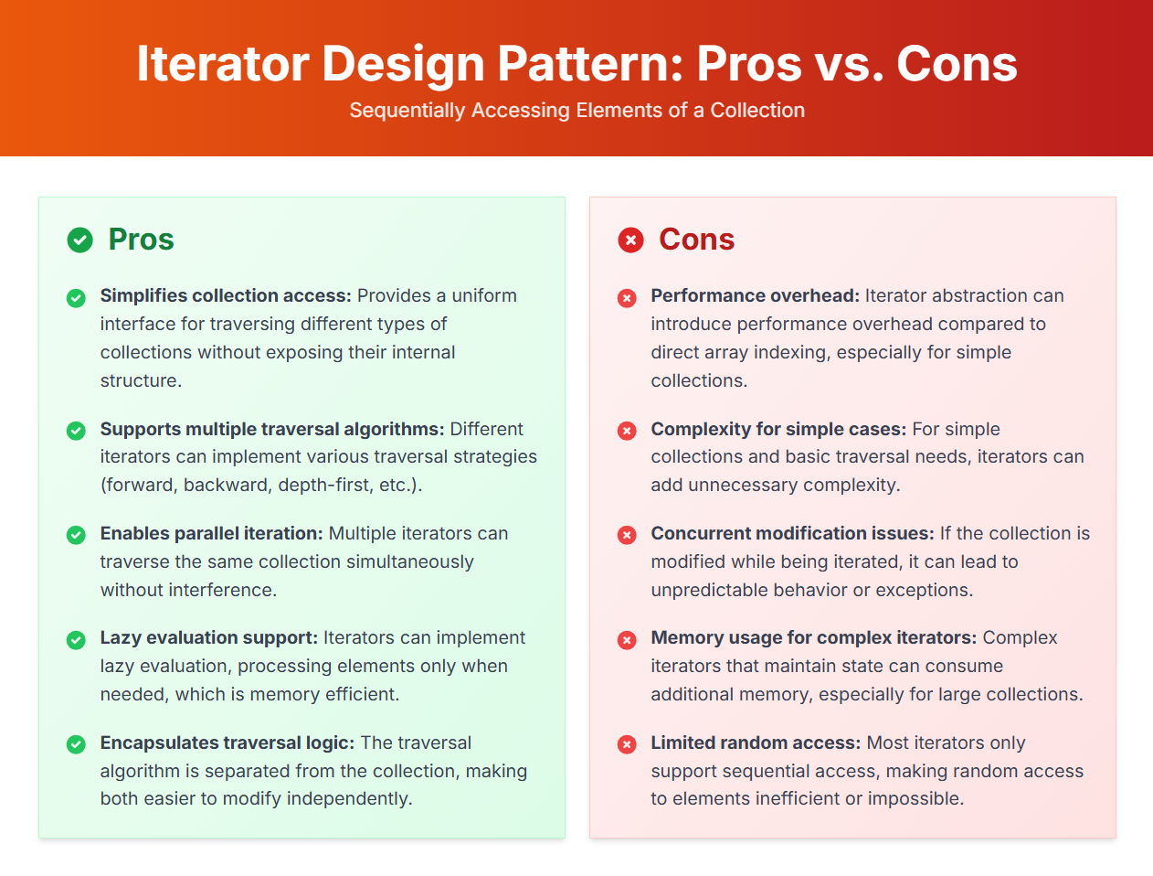

Slide 14
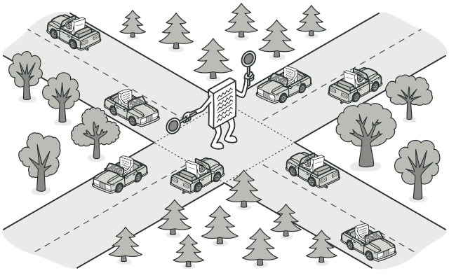
MEDIATOR Mediator is a behavioral design pattern that lets you reduce chaotic dependencies between objects. The pattern restricts direct communications between the objects and forces them to collaborate only via a mediator object.
Applicability
Use the Mediator pattern when it’s hard to change some of the classes because they are tightly coupled to a bunch of other classes.
Use the pattern when you can’t reuse a component in a different program because it’s too dependent on other components.
Use the Mediator when you find yourself creating tons of component subclasses just to reuse some basic behavior in various contexts.
Use Cases: Chat Applications, UI Frameworks.

Slide 15
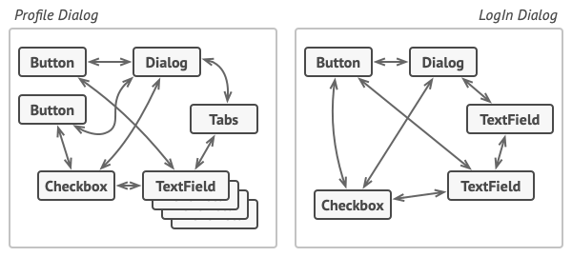
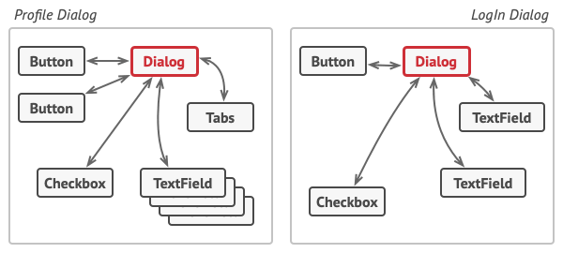
Problem & Solution
Problem
Say you have a dialog for creating and editing customer profiles. It consists of various form controls such as text fields, checkboxes, buttons, etc.
By having this logic implemented directly inside the code of the form elements you make these elements’ classes much harder to reuse in other forms of the app. For example, you won’t be able to use that checkbox class inside another form, because it’s coupled to the dog’s text field. You can use either all the classes involved in rendering the profile form, or none at all.
Solution
The Mediator pattern suggests that you should cease all direct communication between the components which you want to make independent of each other. Instead, these components must collaborate indirectly, by calling a special mediator object that redirects the calls to appropriate components. As a result, the components depend only on a single mediator class instead of being coupled to dozens of their colleagues.

Slide 16
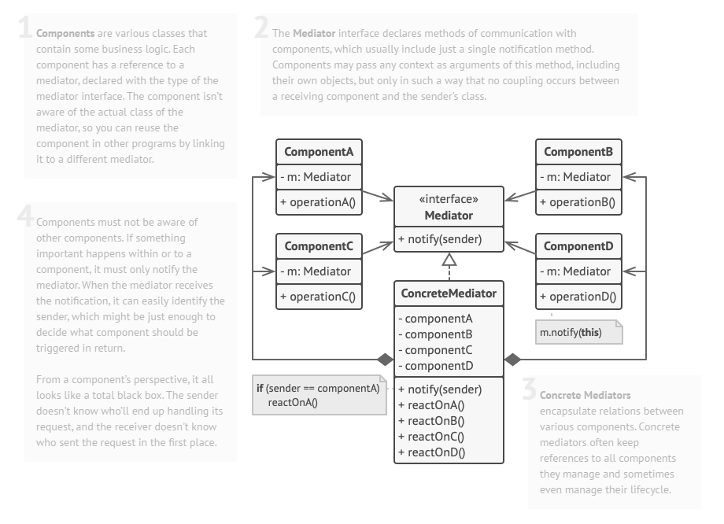
Structure

Slide 17
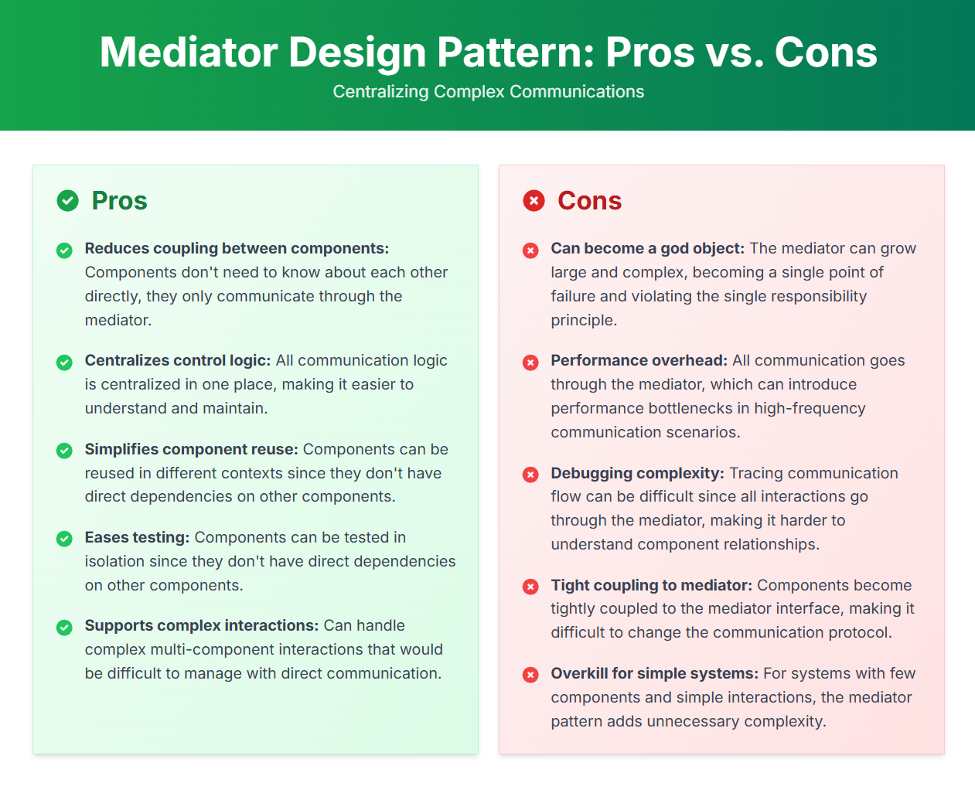

Slide 18
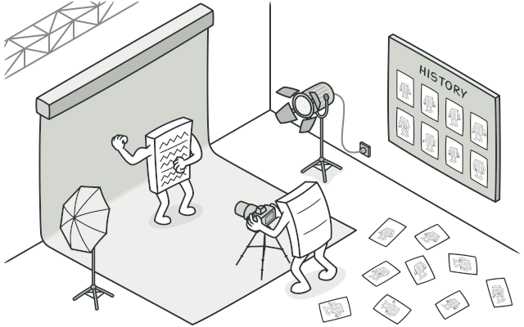
MEMENTO Memento is a behavioral design pattern that lets you save and restore the previous state of an object without revealing the details of its implementation.
Applicability
Use the Memento pattern when you want to produce snapshots of the object’s state to be able to restore a previous state of the object.
Use the pattern when direct access to the object’s fields/getters/setters violates its encapsulation.
Use Cases: Versioning and History Tracking.

Slide 19
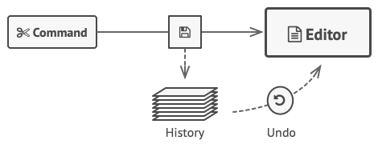
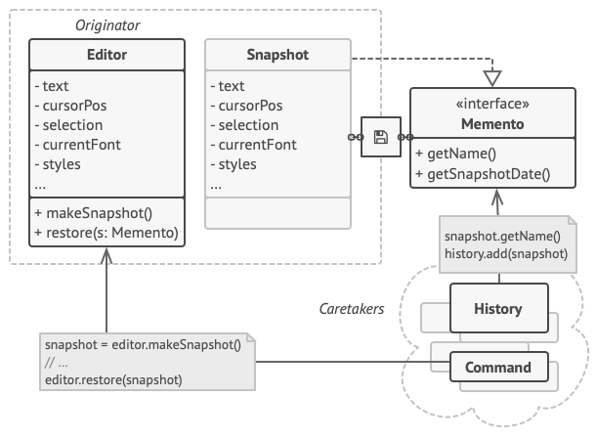
Problem & Solution
Problem
Imagine that you’re creating a text editor app. In addition to simple text editing, your editor can format text, insert inline images, etc.
At some point, you decided to let users undo any operations carried out on the text. This feature has become so common over the years that nowadays people expect every app to have it. For the implementation, you chose to take the direct approach. Before performing any operation, the app records the state of all objects and saves it in some storage. Later, when a user decides to revert an action, the app fetches the latest snapshot from the history and uses it to restore the state of all objects.
Solution
All problems that we’ve just experienced are caused by broken encapsulation. Some objects try to do more than they are supposed to. To collect the data required to perform some action, they invade the private space of other objects instead of letting these objects perform the actual action.
The Memento pattern delegates creating the state snapshots to the actual owner of that state, the originator object. Hence, instead of other objects trying to copy the editor’s state from the “outside,” the editor class itself can make the snapshot since it has full access to its own state.

Slide 20
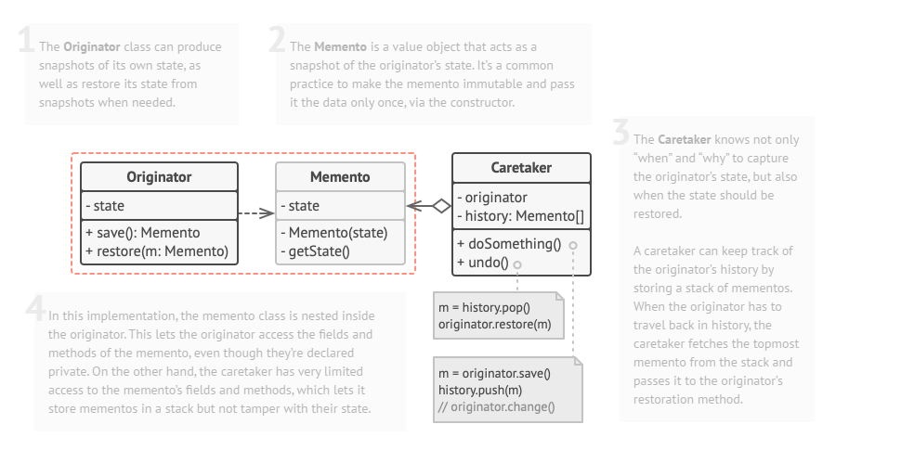
Structure

Slide 21
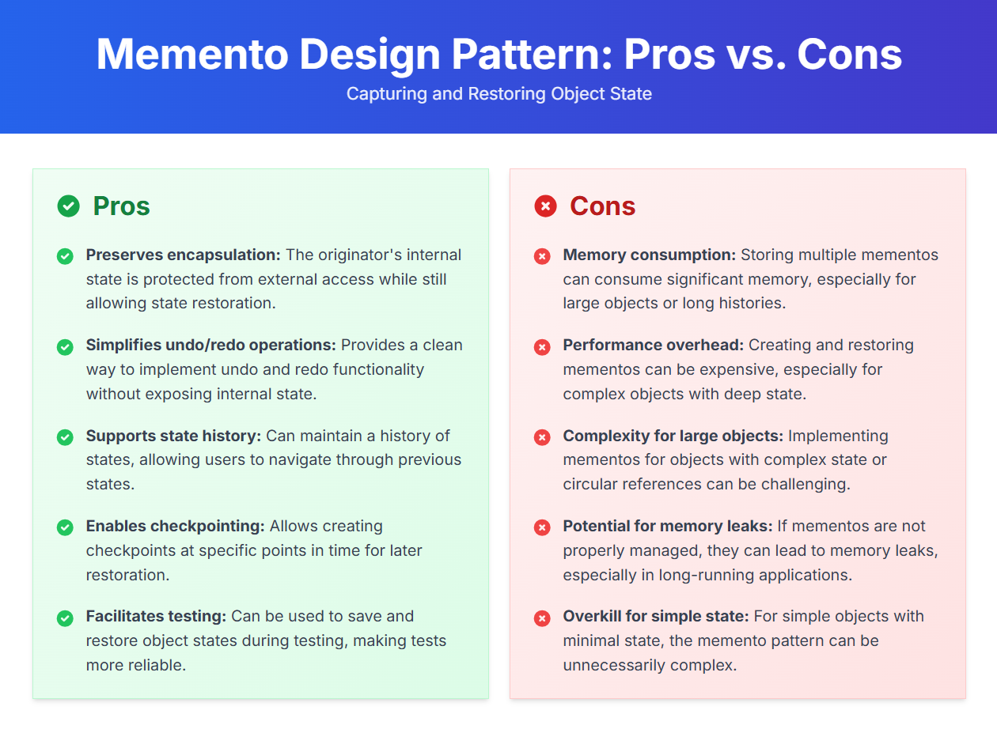

Slide 22
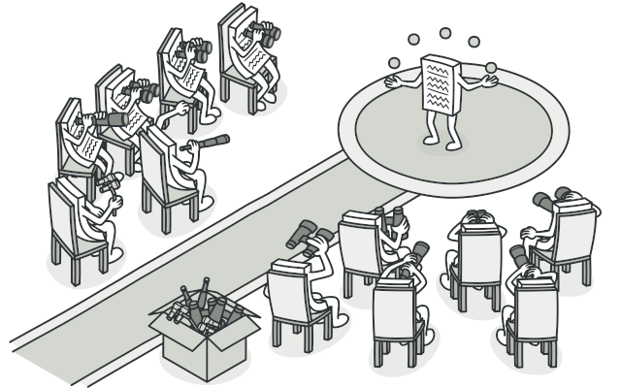
OBSERVER Observer is a behavioral design pattern that lets you define a subscription mechanism to notify multiple objects about any events that happen to the object they’re observing.
Applicability
Use the Observer pattern when changes to the state of one object may require changing other objects, and the actual set of objects is unknown beforehand or changes dynamically.
Use the pattern when some objects in your app must observe others, but only for a limited time or in specific cases.
Use Cases: Notification Systems.

Slide 23
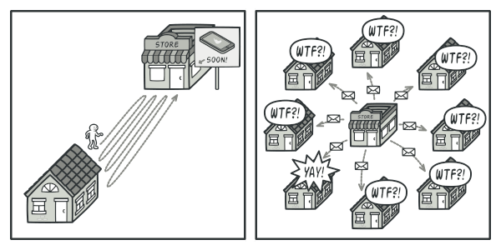
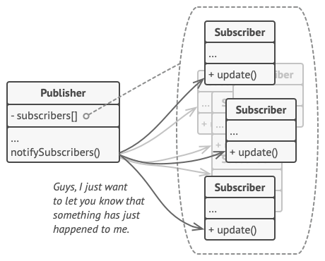
Problem & Solution
Problem
Imagine that you have two types of objects: a Customer and a Store. The customer is very interested in a particular brand of product (say, it’s a new model of the iPhone) which should become available in the store very soon.
The customer could visit the store every day and check product availability. But while the product is still en route, most of these trips would be pointless.
Solution
The object that has some interesting state is often called subject, but since it’s also going to notify other objects about the changes to its state, we’ll call it publisher. All other objects that want to track changes to the publisher’s state are called subscribers.
The Observer pattern suggests that you add a subscription mechanism to the publisher class so individual objects can subscribe to or unsubscribe from a stream of events coming from that publisher. Fear not! Everything isn’t as complicated as it sounds. In reality, this mechanism consists of 1) an array field for storing a list of references to subscriber objects and 2) several public methods which allow adding subscribers to and removing them from that list.

Slide 24
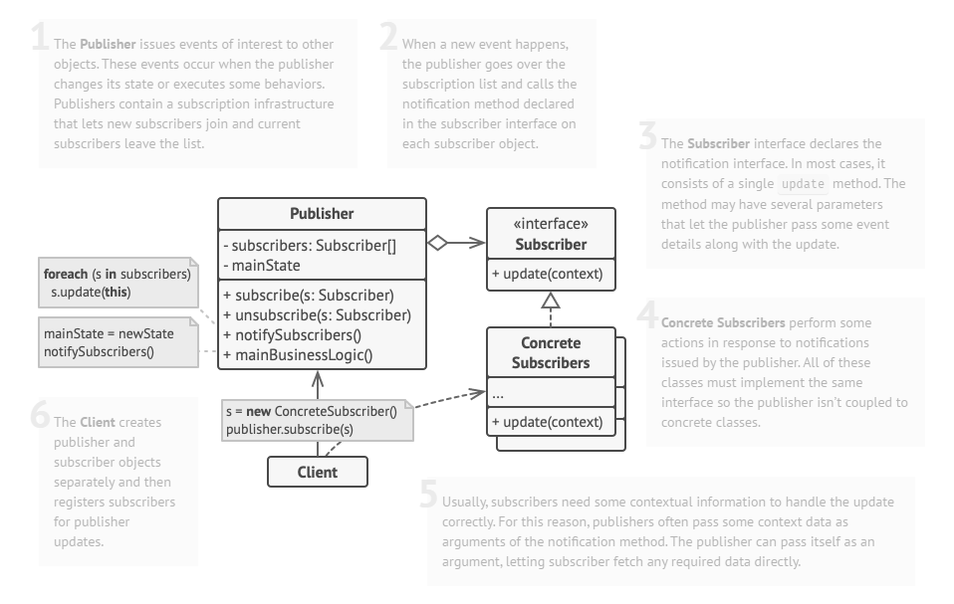
Structure

Slide 25
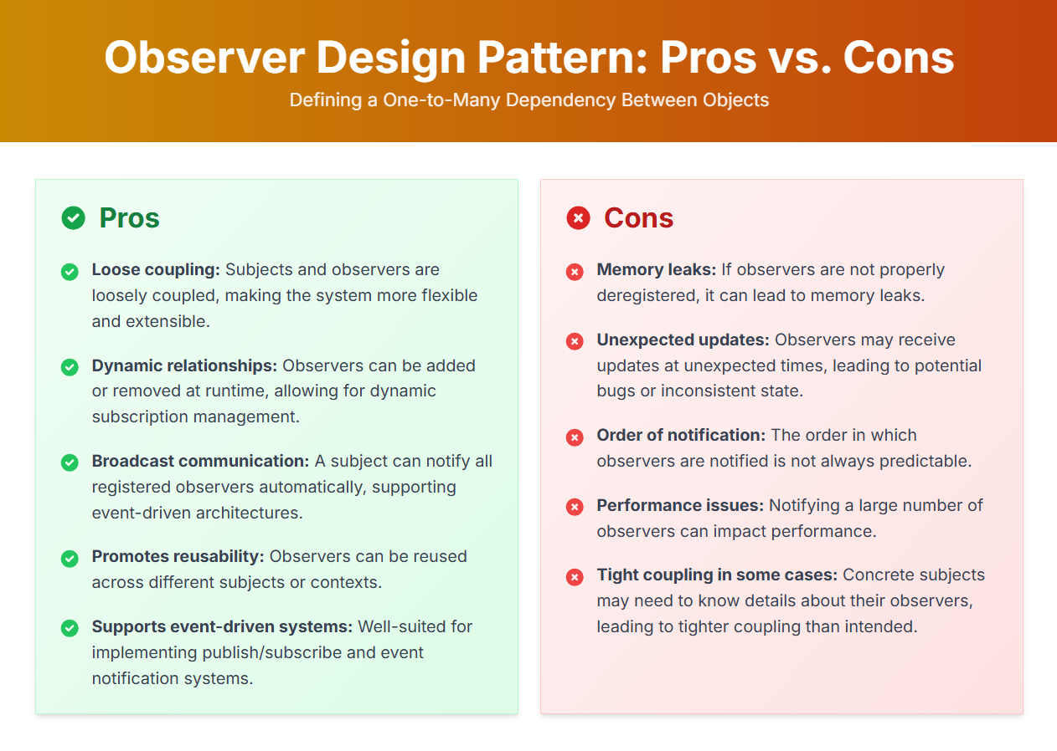

Slide 26
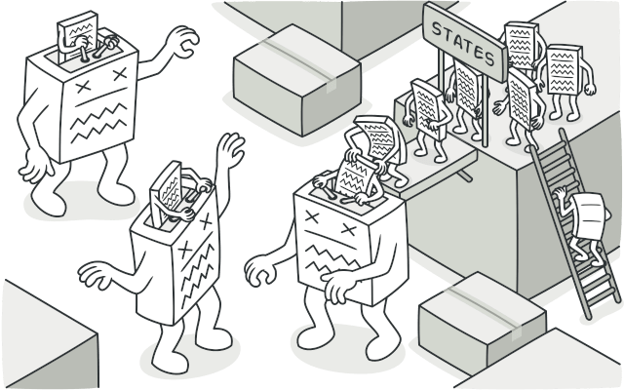
STATE State is a behavioral design pattern that lets an object alter its behavior when its internal state changes. It appears as if the object changed its class.
Applicability
Use the State pattern when you have an object that behaves differently depending on its current state, the number of states is enormous, and the state-specific code changes frequently.
Use the pattern when you have a class polluted with massive conditionals that alter how the class behaves according to the current values of the class’s fields.
Use State when you have a lot of duplicate code across similar states and transitions of a condition-based state machine.
Use Cases: Media Player, Vending Machine.

Slide 27
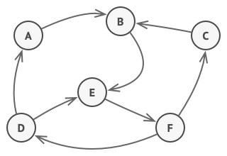
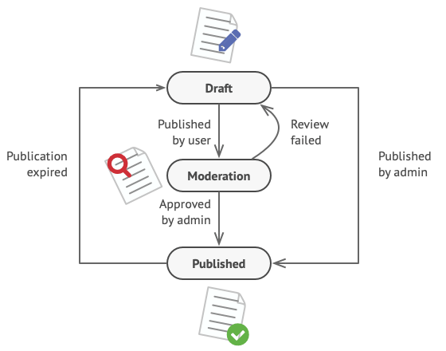
Problem & Solution
Problem
The main idea is that, at any given moment, there’s a finite number of states which a program can be in. Within any unique state, the program behaves differently, and the program can be switched from one state to another instantaneously. However, depending on a current state, the program may or may not switch to certain other states. These switching rules, called transitions, are also finite and predetermined.
Solution
The State pattern suggests that you create new classes for all possible states of an object and extract all state-specific behaviors into these classes.
Instead of implementing all behaviors on its own, the original object, called context, stores a reference to one of the state objects that represents its current state, and delegates all the state-related work to that object.
To transition the context into another state, replace the active state object with another object that represents that new state. This is possible only if all state classes follow the same interface and the context itself works with these objects through that interface.

Slide 28
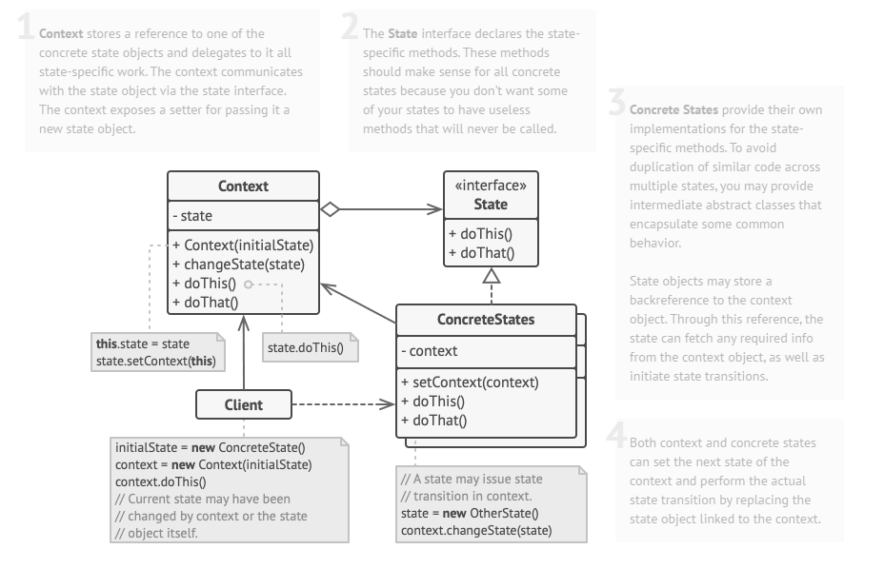
Structure

Slide 29
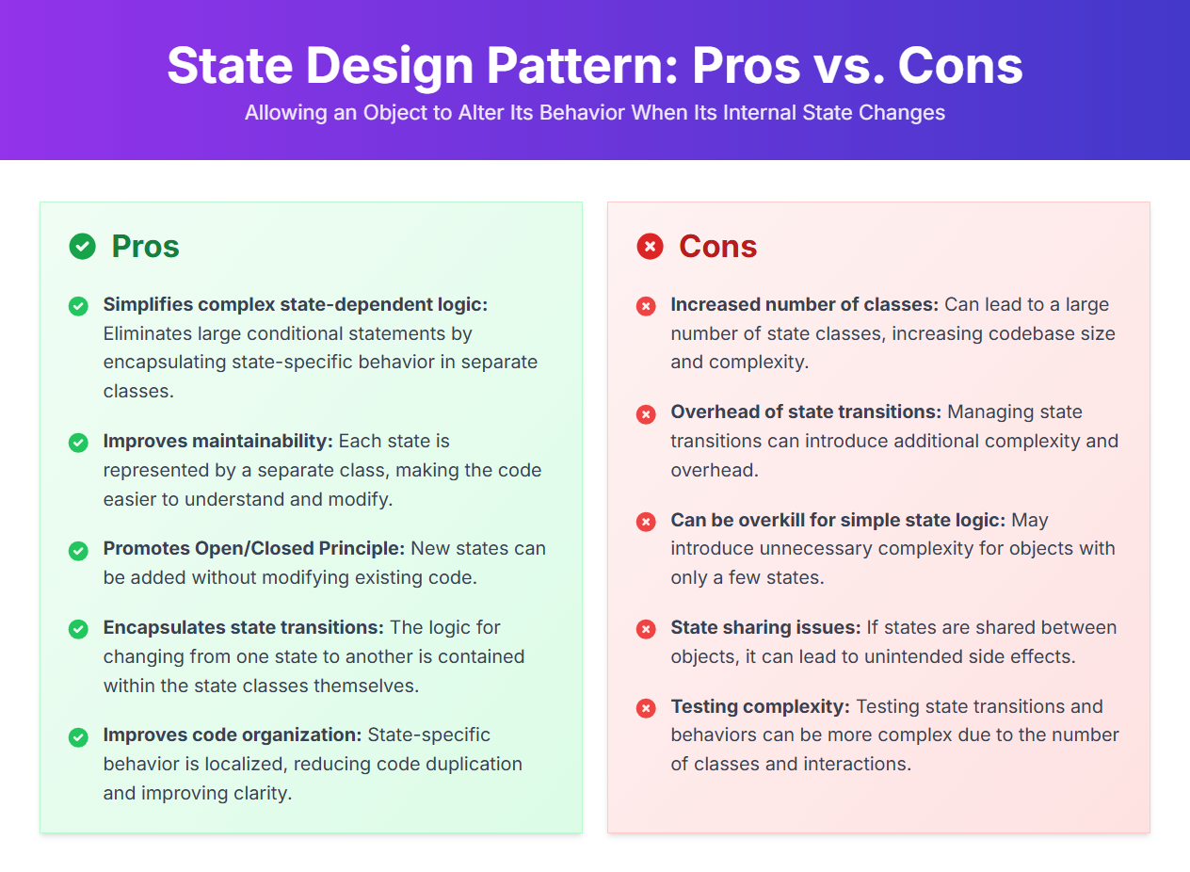

Slide 30
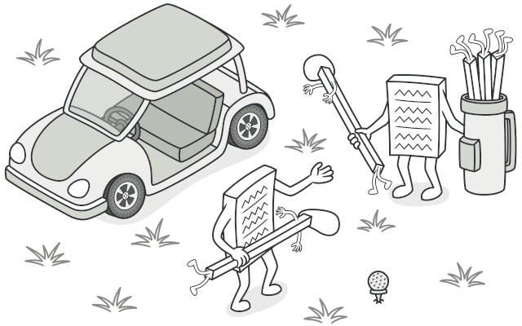
STRATEGY Strategy is a behavioral design pattern that lets you define a family of algorithms, put each of them into a separate class, and make their objects interchangeable.
Applicability
Use the Strategy pattern when you want to use different variants of an algorithm within an object and be able to switch from one algorithm to another during runtime.
Use the Strategy when you have a lot of similar classes that only differ in the way they execute some behavior.
Use the pattern to isolate the business logic of a class from the implementation details of algorithms that may not be as important in the context of that logic.
Use the pattern when your class has a massive conditional statement that switches between different variants of the same algorithm.
Use Cases: Payment Processing, File Format Conversion.

Slide 31
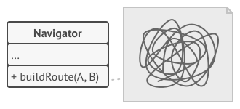
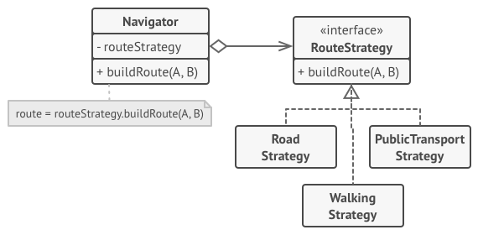
Problem & Solution
Problem
One day you decided to create a navigation app for casual travelers. The app was centered around a beautiful map which helped users quickly orient themselves in any city.
The first version of the app could only build the routes over roads. People who traveled by car were bursting with joy. But apparently, not everybody likes to drive on their vacation. So with the next update, you added an option to build walking routes. Right after that, you added another option to let people use public transport in their routes.
Solution
The Strategy pattern suggests that you take a class that does something specific in a lot of different ways and extract all of these algorithms into separate classes called strategies.
The original class, called context, must have a field for storing a reference to one of the strategies. The context delegates the work to a linked strategy object instead of executing it on its own.
The context isn’t responsible for selecting an appropriate algorithm for the job. Instead, the client passes the desired strategy to the context. In fact, the context doesn’t know much about strategies. It works with all strategies through the same generic interface, which only exposes a single method for triggering the algorithm encapsulated within the selected strategy.

Slide 32
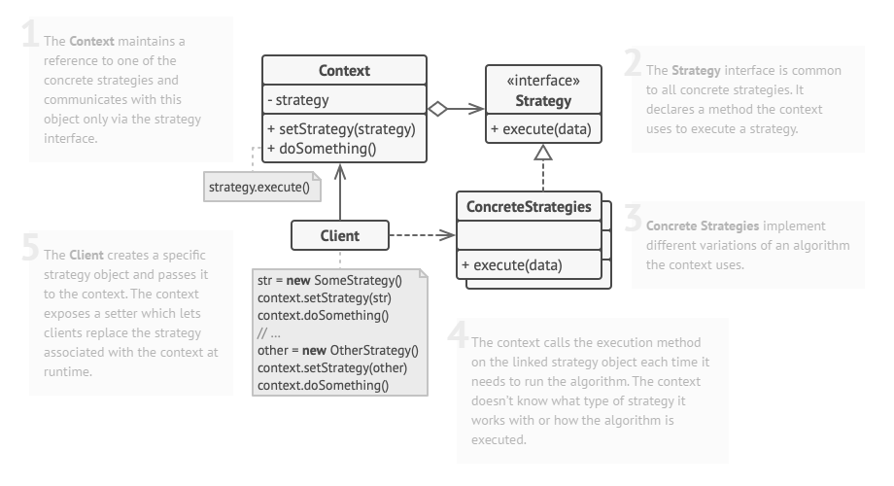
Structure

Slide 33
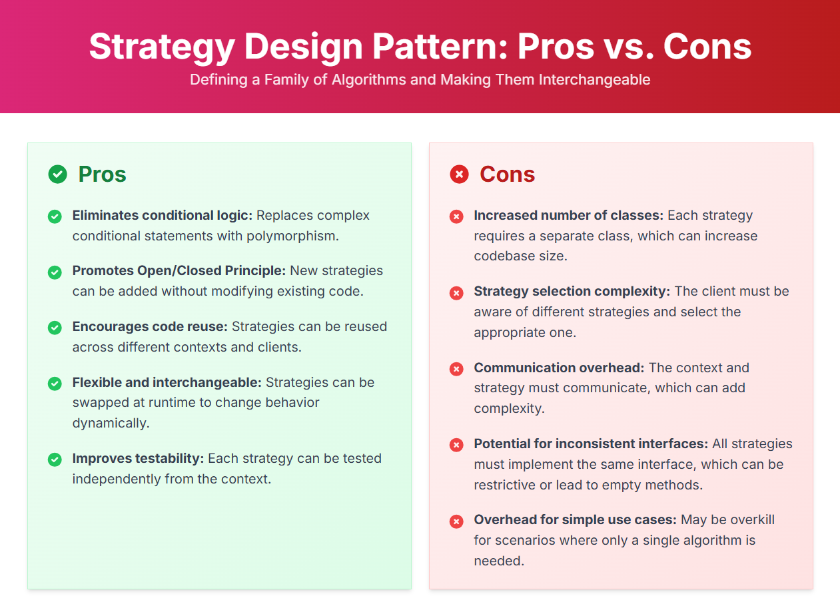

Slide 34
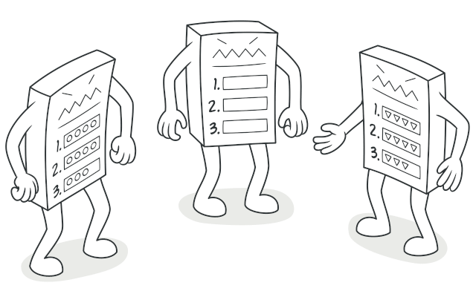
TEMPLATE METHOD Template Method is a behavioral design pattern that defines the skeleton of an algorithm in the superclass but lets subclasses override specific steps of the algorithm without changing its structure.
Applicability
Use the Template Method pattern when you want to let clients extend only particular steps of an algorithm, but not the whole algorithm or its structure.
Use the pattern when you have several classes that contain almost identical algorithms with some minor differences. As a result, you might need to modify all classes when the algorithm changes.
Use Cases: Data Serialization/Deserialization, Standardizing Processes

Slide 35
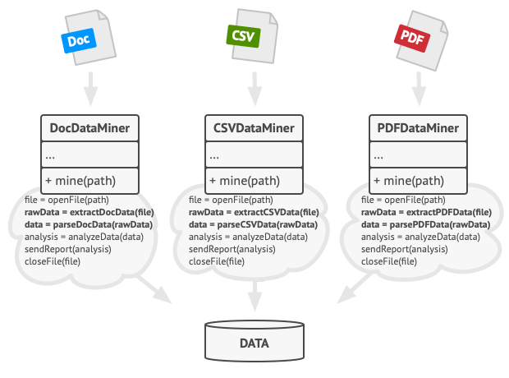
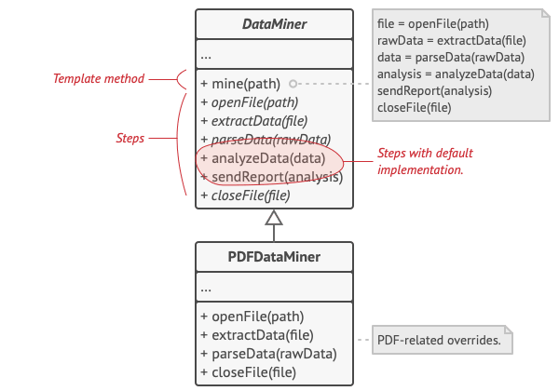
Problem & Solution
Problem
Imagine that you’re creating a data mining application that analyzes corporate documents. Users feed the app documents in various formats (PDF, DOC, CSV), and it tries to extract meaningful data from these docs in a uniform format.
The first version of the app could work only with DOC files. In the following version, it was able to support CSV files. A month later, you “taught” it to extract data from PDF files.
Solution
The Template Method pattern suggests that you break down an algorithm into a series of steps, turn these steps into methods, and put a series of calls to these methods inside a single template method. The steps may either be abstract, or have some default implementation. To use the algorithm, the client is supposed to provide its own subclass, implement all abstract steps, and override some of the optional ones if needed (but not the template method itself).
Let’s see how this will play out in our data mining app. We can create a base class for all three parsing algorithms. This class defines a template method consisting of a series of calls to various document-processing steps.

Slide 36
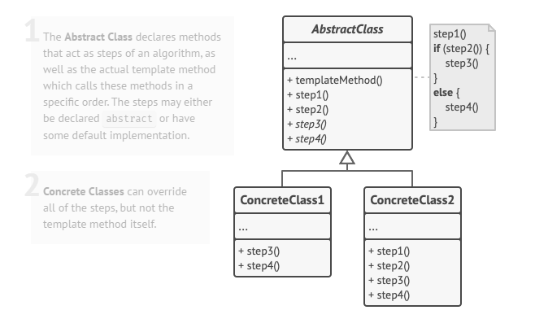
Structure

Slide 37
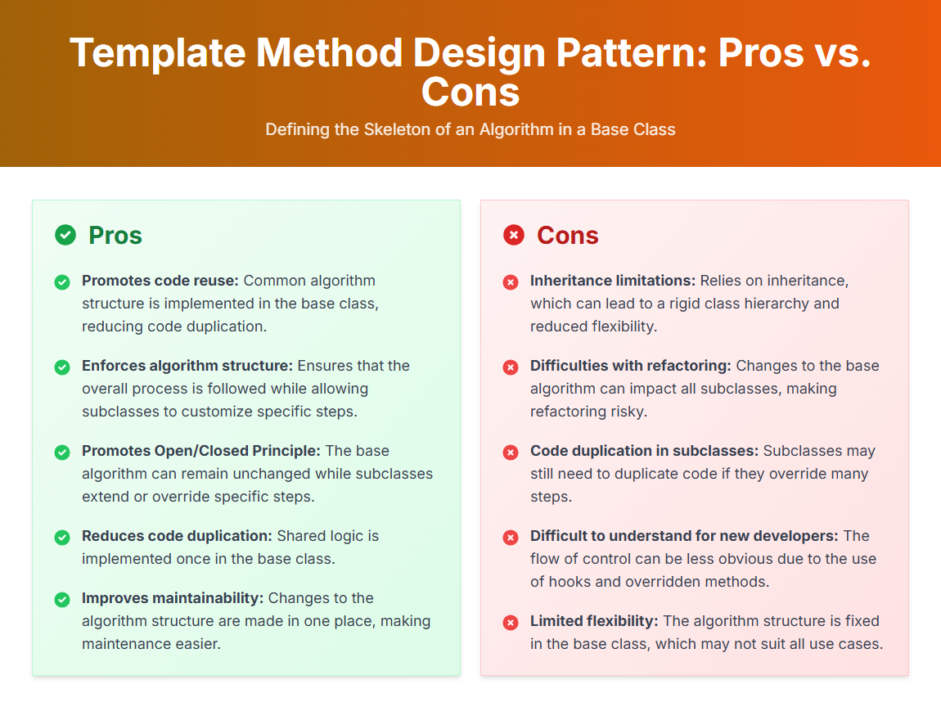

Slide 38

VISITOR Visitor is a behavioral design pattern that lets you separate algorithms from the objects on which they operate.
Applicability
Use the Visitor when you need to perform an operation on all elements of a complex object structure (for example, an object tree).
Use the Visitor to clean up the business logic of auxiliary behaviors.
Use the pattern when a behavior makes sense only in some classes of a class hierarchy, but not in others.
Use Cases: Compilers and interpreters, UI Frameworks.

Slide 39


Problem & Solution
Problem
Imagine that your team develops an app which works with geographic information structured as one colossal graph. Each node of the graph may represent a complex entity such as a city, but also more granular things like industries, sightseeing areas, etc. The nodes are connected with others if there’s a road between the real objects that they represent. Under the hood, each node type is represented by its own class, while each specific node is an object.
Solution
The Visitor pattern suggests that you place the new behavior into a separate class called visitor, instead of trying to integrate it into existing classes. The original object that had to perform the behavior is now passed to one of the visitor’s methods as an argument, providing the method access to all necessary data contained within the object.
Now, what if that behavior can be executed over objects of different classes? For example, in our case with XML export, the actual implementation will probably be a little bit different across various node classes. Thus, the visitor class may define not one, but a set of methods, each of which could take arguments of different types.

Slide 40

Structure

Slide 41


